Slide 1
TOPIC B2:
PROGRAMMING
LESSON B2-11
SORTING ALGORITHMS

Slide 2
AGENDA
Warm Up Question
Bubble Sort
Selection Sort
NOTE!
Have a way to take notes and a way to write code available for this lesson

Slide 3

THE WARM UP QUESTION
Y’all are gonna love this one
Write the binary search algorithm from memory (as best you can)
(yes, again)

Slide 4
THE WARM UP ANSWER
nums = [2, 5, 9, 11, 15, 19, 20, 23, 27, 29, 30, 31, 34, 36] key = 11 found = False lower = 0 upper = len(nums) mid = 0 while lower <= upper and found == False: mid = int((lower+ upper)/2) if nums[mid] == key: found = True elif nums[mid] < key: lower = mid + 1 else: upper = mid - 1 if found: print('The value was found at index', mid) else: print("The value was not found")

Slide 5

SORTING ALGORITHMS
To use the binary search we discussed last time (and re-created earlier) the list must be sorted
The problem, is that data doesn’t always come pre-sorted to us on a silver platter
So, what happens when we need to re-arrange a list to be sorted?

Slide 6
SORTING ALGORITHMS
Sorting algorithms are used to take a list of unsorted items and sort them from smallest to largest
This is easiest done using a list of integers, but strings can also be evaluated based on where they would be sorted alphabetically
Of course, sorting items seems like a complex task, and sometimes can be hard for us
So how do we do this ourself?

Slide 7
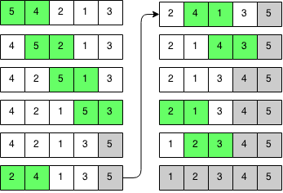
BUBBLE SORT
Bubble sort uses an incremental approach
The goal, as summarized, is to “Bubble up” the largest item to the end of the list
Then, we rinse and repeat with the second largest item to the second to last position in the list
So on and so forth until the list is inevitably sorted.

Slide 8
BUBBLE SORT
The algorithm works as follows:
Start at the beginning of the list
Compare the current element with the next one
If the two values are not in order, swap their contents
Move to the next element in the list
Repeat until all elements have been sorted
Let’s work through an example together

Slide 9
BUBBLE SORT
Here’s the Python code for the bubble sort algorithm
Let’s walk through this algorithm
nums = [12, 4, 88, 13, 99, 0, 86, 23] for i in range(0, len(nums)): for j in range(0, len(nums)-i-1): if nums[j+1] < nums[j]: temp = nums[j] nums[j] = nums[j+1] nums[j+1] = temp print(nums)

Slide 10
BUBBLE SORT
What is the time complexity of this algorithm?
nums = [12, 4, 88, 13, 99, 0, 86, 23] for i in range(0, len(nums)): for j in range(0, len(nums)-i-1): if nums[j+1] < nums[j]: temp = nums[j] nums[j] = nums[j+1] nums[j+1] = temp print(nums)

Slide 11
BUBBLE SORT
Bubble sort isn’t what I’d call a particularly ‘efficient’ algorithm.
If you have a very large list, the time complexity of O(n²) will quickly add up and make this program take a while to run
In terms of space complexity, this algorithm does not take up any more space than the original list does, which isn’t considered, so the bubble sort has a space complexity of O(1)

Slide 12
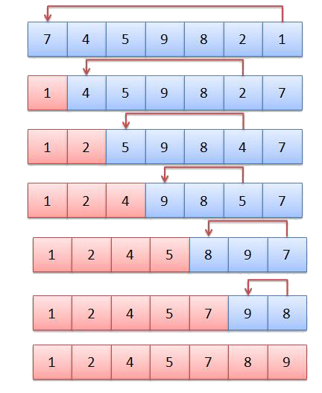
SELECTION SORT
Selection sort isn’t that dissimilar from the Bubble sort
Instead of bubbling up the largest elements, we select the smallest element and sort that first, working up to the largest element

Slide 13
SELECTION SORT
First, we loop through the list to find the smallest element
Then, we swap that element into the first position of the list
Then, we loop to find the second smallest element
And we swap that into the second position of the list
Let’s work through an example

Slide 14
SELECTION SORT CODE
Here’s the Python code for the selection sort algorithm
Let’s walk through this algorithm
nums = [4, 56, 88, 9, 44, 12, 23, 66, 0, -5, 36] for i in range(len(nums)-1): min = i for j in range(i+1, len(nums)): if nums[j] < nums[min]: min = j temp = nums[i] nums[i] = nums[min] nums[min] = temp print(nums)

Slide 15
SELECTION SORT CODE
What’s the time complexity for this algorithm?
nums = [4, 56, 88, 9, 44, 12, 23, 66, 0, -5, 36] for i in range(len(nums)-1): min = i for j in range(i+1, len(nums)): if nums[j] < nums[min]: min = j temp = nums[i] nums[i] = nums[min] nums[min] = temp print(nums)

Slide 16


SELECTION SORT
Because this algorithm is also O(n²), it isn’t really any more efficient than Bubble Sort
The only upside with this algorithm is that the program may need to swap fewer variables
This can be more efficient on certain, very old hardware where the CPU can’t swap variables effectively
The space complexity here is also O(1)

Slide 17
SORTING EFFICIENCY
Because these algorithms are O(n²), using one to justify a binary search doesn’t result in an actual efficiency improvement
O(n²) (bubble/selection sort) + O (log₂n) (binary search) = O(n²)
Using a linear search on an unsorted list is still faster
O(n²) > O(n)
Even our most complex, intricate sorting algorithms only ever get the efficiency to O(n * log₂n)

Slide 18

VOCAB TO REMEMBER
Sorting Algorithm
Bubble Sort
Selection Sort

Slide 19
PA PA PA PA PA PA PA PA PA PA AP PA
Find PA B2-5 On GitHub… or else

